Slide 1






Project Title
DEEP FAKE DETECTION
Team Members:
Gudditi Kalyan (gudditikalyan123@gmail.com)
Guduru Phaneendra (phaneendraguduru6@gmail.com)
Madham Kiran Kumar (mkirankumar6839@gmail.com)
Thumati Rajiv Kumar (thumatirajivkumar@gmail.com)
Guide: Saomya Chaudhury

Slide 2
OUTLINE
Project Title
Abstract
Problem Statement
Aims, Objective & Proposed System/Solution
System Design/Architecture
System Development Approach
Algorithm & Deployment
Conclusion
Future Scope
References
Video of the Project

Slide 3
Abstract
Project Title
Deepfake detection focuses on identifying and preventing the spread of manipulated media, such as videos, audio, or images, created using AI techniques like generative adversarial networks (GANs). These falsified media can pose serious risks by spreading misinformation, compromising privacy, and undermining trust in digital content. This project explores various methods of detecting deepfakes, primarily through analyzing inconsistencies in visual, audio, and temporal features. By employing machine learning and computer vision techniques, deepfake detection aims to safeguard against malicious uses of synthetic media and maintain the integrity of digital communication.

Slide 4
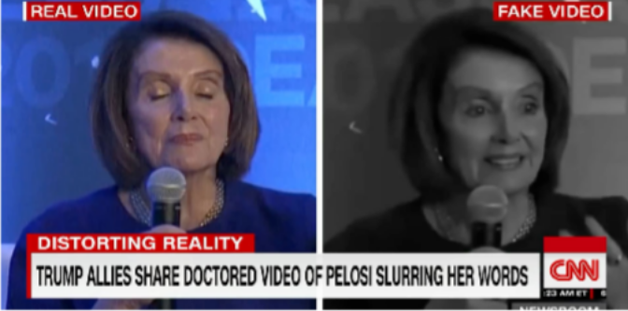
Problem Statement
Project Title
Deepfakes can distort our perception of the truth and we need to develop a strategy to improve their detection. Deep Fakes are increasingly detrimental to privacy, social security, and democracy. We plan to achieve better accuracy in predicting real and fake videos
What is a Deep-fake?
Using Artificial Intelligence and Deep Neural Networks for synthetically manipulating or generating fake videographic content

Slide 5
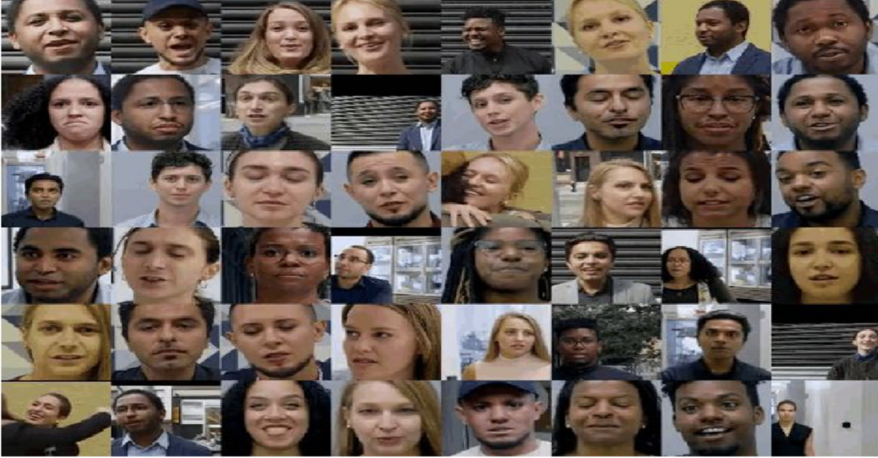
Project Title
Examples:
A sample of videos from Google’s contribution to the Face Forensics benchmark. To generate these, pairs of actors were selected randomly and deep neural networks swapped the face of one actor onto the head of another.

Slide 6
Aim and Objective
Project Title
Aim:
The aim of project is to develop an effective deep fake detection system to identify and combat the spread of deep fake content.
Objectives:
Identifying Altered Content, Preserving Trust, Preventing Misinformation and Disinformation, Creating Countermeasures and Protecting Privacy and Security.

Slide 7
Proposed Solution
Project Title
1
2
3
4
Data Collection
Model Architecture
Training and Optimization
Deployment and Evaluation
Gather a diverse dataset of real and deepfake media samples.
Design a deep learning model tailored for robust deepfake detection.
Iteratively train and fine- tune the model to achieve high accuracy.
Deploy the model in real- world scenarios and assess its performance.

Slide 8
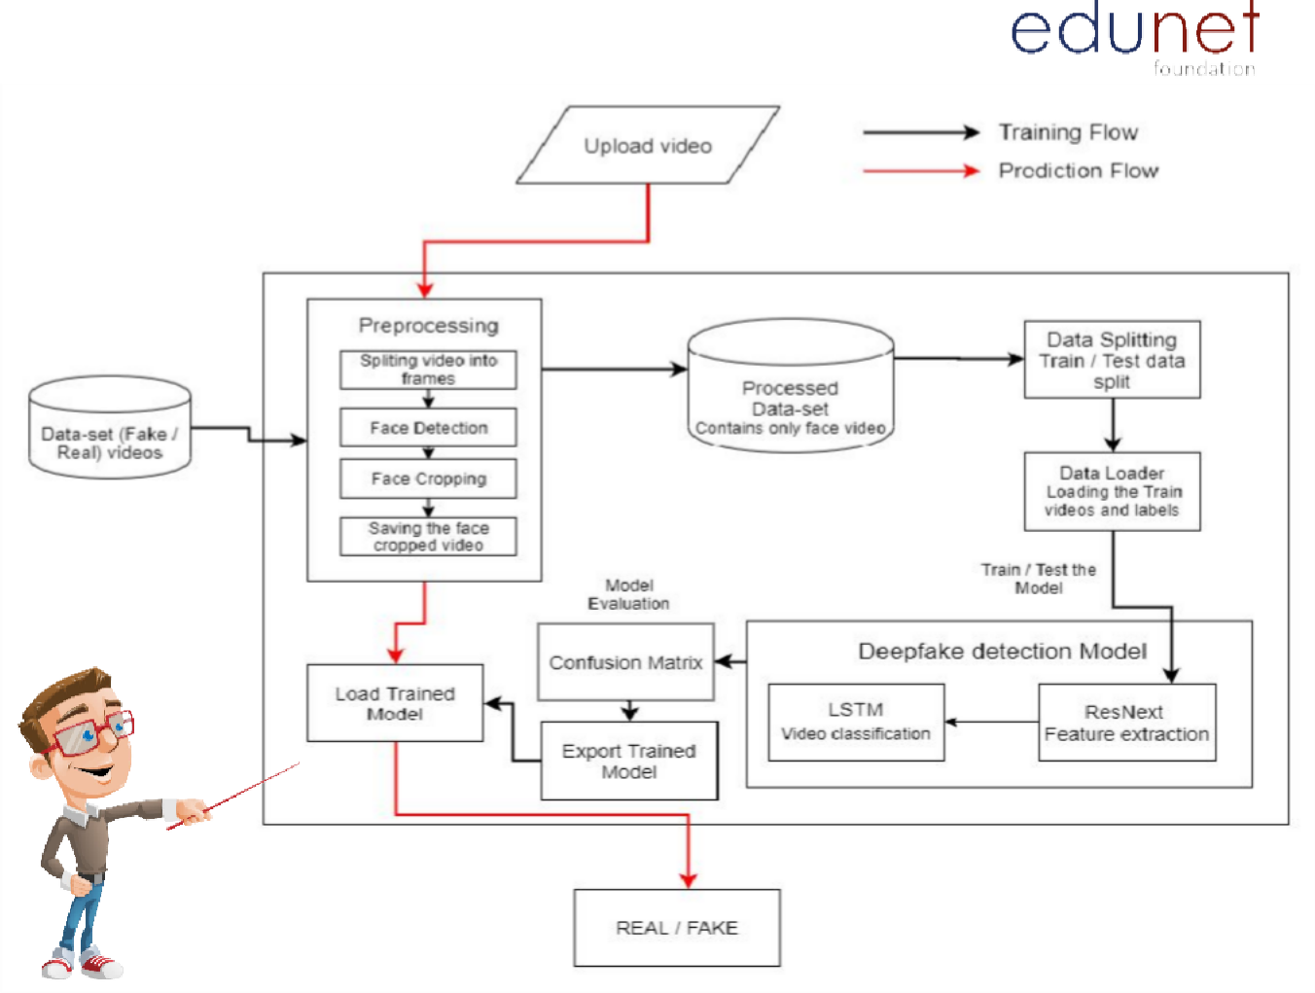
Project Title
System Architecture

Slide 9
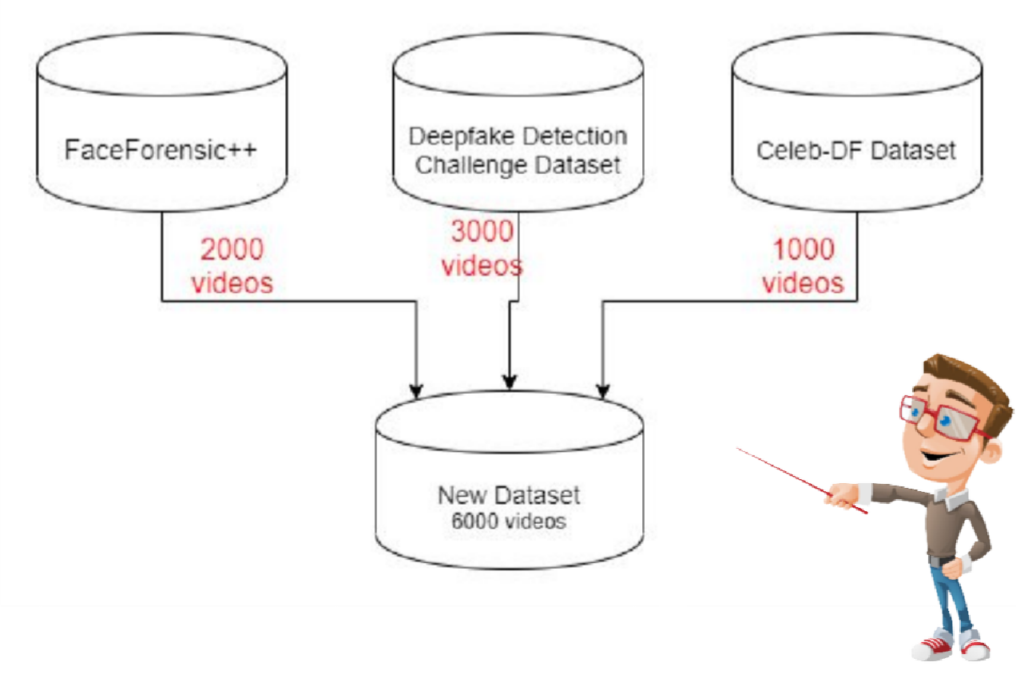
Project Title
Data-set Exploration

Slide 10

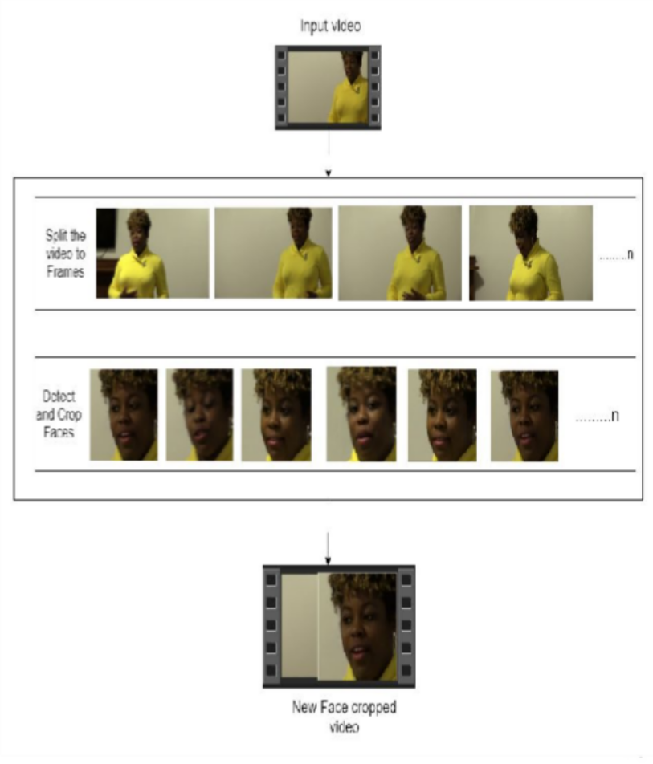









Project Title
SPLIT VIDEO INTO FRAMES
1
2
FACE DETECTION
Pre- processing
3
CROPING FACE
CREATING NEW FACE CROPPED VIDEO
4
5
SAVING THE FACE CROPPED VIDEO

Slide 11
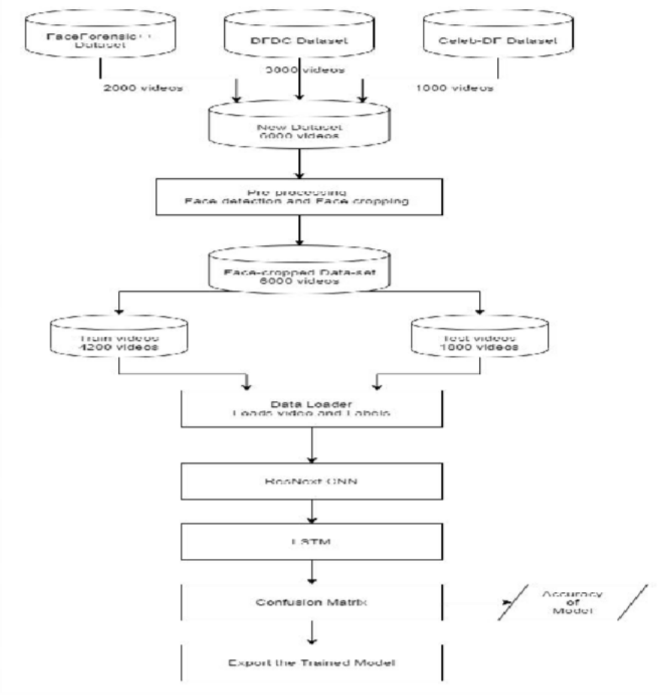
Project Title
Training Workflow

Slide 12



















Project Title
Python and their libraries
Programming Frameworks
Tensorflow
keras
Tools and Technologies
IDE
Google
Jupyter Notebook
Visual Studio Code
Cloud Services
Google Cloud Platform
Version Control
Git

Slide 13
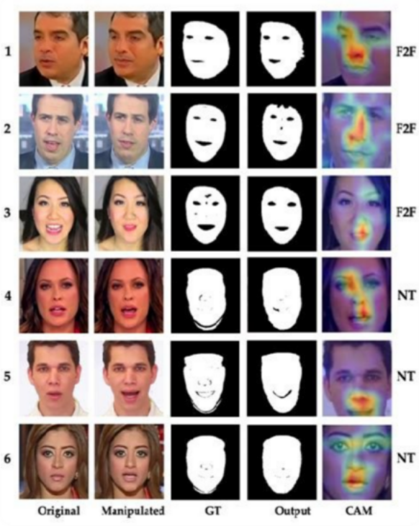
Future work of Deepfake Detection
Project Title
1
Improvement of AI Detection Models
More accurate tools using AI to analyze deepfake patterns in real-time.
2
Ongoing Challenges
Continued research is needed to address evolving deepfake generation techniques and enhance detection capabilities.
3
Public Awareness and Education
Teaching people how to spot deepfakes and raising awareness of their risks.

Slide 14
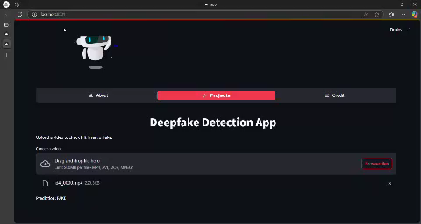
Project Title
Video of the project:

Slide 15
References :
Project Title
Data set:
Face Forensics ++ Real and fake processed videos(https://github.com/ondyari/FaceForensics)
Celeb-DF Fake processed videos ( https://github.com/yuezunli/celeb-deepfakeforensics)
Celeb-DF Real processed videos https://github.com/yuezunli/celeb-deepfakeforensics
DFDC Fake processed videos https://www.kaggle.com/c/deepfake-detection-challenge/data
DFDC Real processed videoshttps://www.kaggle.com/c/deepfake-detection-challenge/data
My github link: https://github.com/M6839/Deep_Fake_Detection.git
Video of project: https://drive.google.com/file/d/1XffTspWWa6isclsNoZ17ZI6rW-H6-04-/view?usp=drivesdk

Slide 16
Thank you!
Project Title

